Slide 1
Lecture no. 1

Slide 2
What is Planning?
Planning (also called forethought) is the process of thinking about and organizing the activities required to achieve a desired goal. Planning involves the creation and maintenance of a plan.
Planning is one of the executive functions of the brain, encompassing the neurological processes involved in the formulation, evaluation and selection of a sequence of thoughts and actions to achieve a desired goal.

Slide 3
What is Town Planning?
The art and science of ordering the use of land and siting of buildings and communication routes so as to secure the maximum practicable degree of economy, convenience, and beauty.
An attempt to formulate the principles that should guide us in creating a civilized physical background for human life whose main impetus is thus … foreseeing and guiding change.

Slide 4
General Definition and Terms used in Town Planning
PLAN:
A plan is typically any diagram or list of steps with timing and resources, used to achieve an objective.
Grid Plan
The grid plan, grid street plan or grid iron plan is a type of city plan in which streets run at right angles to each other, forming a grid. In the context of the culture of ancient Greece Hippodamian plan.

Slide 5
To be continue….
City Planner
City planner helps design cities and makes such determinations as the height of buildings, the width of streets, the number of street signs, and the design and location of street, deciding how a width of streets, the number of street signs, and the design and location of street. Deciding how a city is set up involves creativity, and a career in the city planning demands the knowledge of the basic engineering principles, the ability to compromise, political diplomacy, and financial aspects. Strong analytic skills and sheer force of will are required to be a successful urban planner.

Slide 6
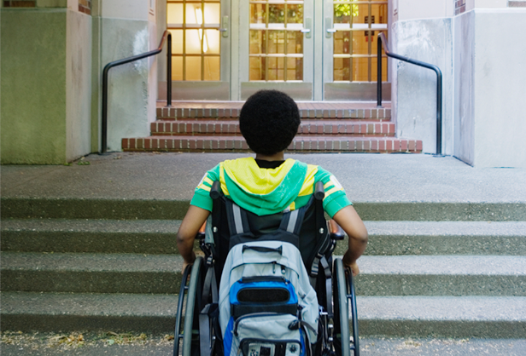
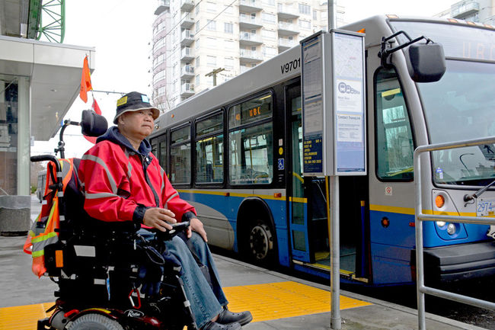
To be continue….
Accessibility
It refers to approach or reach or access or mode of communication. In terms of planning it is a concept or idea of accessible design which ensures the direct or indirect means of access or approach.

Slide 7
To be continue….
Comprehensive Plan
It contains a detailed and long term planning of any piece of land which inhales and accomplish the community goals in order to develop a community. The strategic vision having large areas and wide range to cover containing ideas of proper position and proportion of amenities, distribution networks, recreational and commercial areas and the housing most of all by the implementation of the public policies with their consultation.
Infrastructure
The basic facilities necessary to live in a town or city or any piece of land like transportation, communication facilities, sewage and drainage system, water and electric system. A planner is concerned to provide these facilities properly and efficiently.

Slide 8
To be continue….
Land Use
Land use is the distribution of land for different purposes. It includes management and properly distribution and division of a piece of land into such environment which includes the settlements and maintenance of the land in order to make it beautiful and beneficial and the same time.
Mixed Land Use
It is the use of land for development of a city, town or even a single building in such a way that it contains residential and commercial areas on a single space. It includes mixture of residential and commercial areas, green spaces and open spaces, recreational activities and officers in order to provide a complete pedestrian connection to particular space, which replaces the use of cars by public transportation and pedestrian.

Slide 9
To be continue….
New Urbanism
An integrated housing scheme which contains residential and commercial areas, recreational and public facilities, and amenities in a compact form at walk able distance not scattered in the whole area but beautifully arranged so as not to suffer in automobiles and not only to provide the facilities but also to provide such area of residency that is attractive.
Sustainable Development
The idea imposed by the sociological and technological organization so as not to suffer when problems may occur in future. It is also defined as to protecting and restoring urban areas in such a way that it gives us a good impact in a compact form. It is the road map for the sustaining of the society to meet present and future needs as well.

Slide 10
To be continue….
Transit Oriented Development
It is described as residential and commercial zones provided to maximize access by transit transportation and with other such features to discourage the congestions and private transport in order to provide transit and friendly environment.
Mixed use development which provide shops, school.
Parking and automobile management to reduce burden
Transit stations that are accessible secure and luxurious.

Slide 11
To be continue….
Urban Sprawl
The ill-mannered and haphazard spreading and scattering low density single use development of a town away from urban areas, which results in the inefficient use of the infrastructure and the increased use of automobiles as the residential and commercial areas have high segregation between them

